Slide 1

Forschungspraktikum IT-Sicherheit SS 2023
AI & Covid
Supervisor: Prof. Dr. Andreas Mauthe (Institut für Wirtschafts- und Verwaltungsinformatik, FG IT Security and Data Security)
Second Supervisor: Mike Reuther (Institut für Wirtschafts- und Verwaltungsinformatik, FG IT Security and Data Security)

Slide 2
Members
Abdullah Md Humayun Kabir
Tanzina Mollah
Shayekh Mohiuddin Ahmed Navid
M Rashedul Hasnat
Jesmin Aktar Mousumy
Saborni Shernaj Binte Elahi
Jahid Hasan Polash
Kazi Mostafa Shahriar
Adnan K M Wahid
Kamrun Nahar
Bosede Osayande
Parminder Kaur Grewal
https://www.hs-koblenz.de/en/rmc/international-office/projects-and-events/translate-to-english-koalas

Slide 3
Research Question 1
Q-

Slide 4
Research Question 2
Q.

Slide 5
Overview
2. Model & Parameter Selection
1. Data Preprocessing
7. Report Writing
6. Synchronization Testing
4. Analysis & Resilience Testing
5. Data Validation Framework
8. Presentation
3. Train Model assessment- outcome

Slide 6
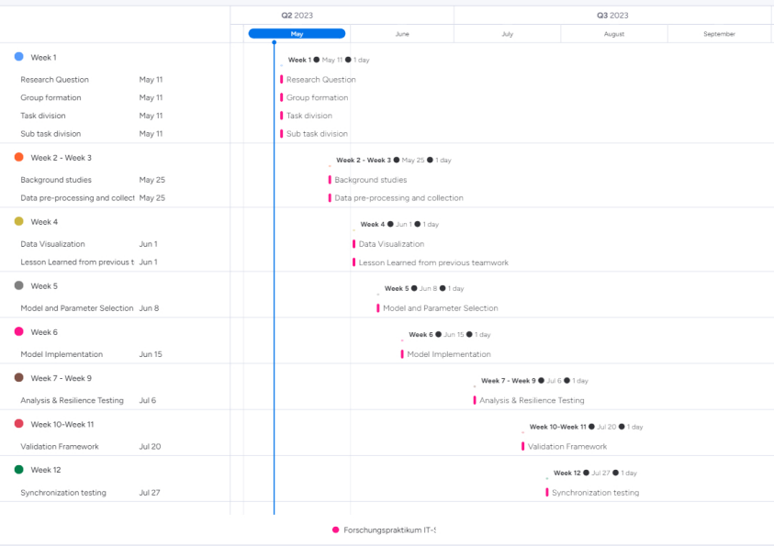
Gantt Chart
Monday Work Management Tool

Slide 7

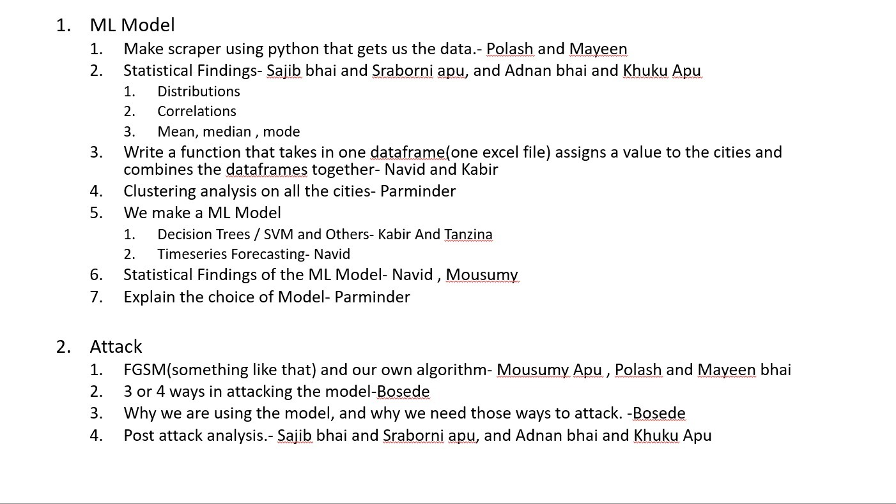
Work Distribution

Slide 8
Work Progress(Till Date)

Slide 9

Questions
https://www.slideteam.net/powerpoint/Any-Questions

Slide 10

https://stock.adobe.com/de/search?k=thank%20you

